Slide 1


UniLM Unified pre-trained Language Model
by Gholamreza Dar

Slide 2
Overview
Language Models
UniLM v1
Results
Improvement via UniLM v2
Results
Conclusion
References

Slide 3
Language Models
“A language model is a function that, given a sequence of words, returns the probability of the next words”
Rise of Pretrained Language Models
Famous LMs
ELMO (Two unidirectional LMs)
GPT (Left-to-right transformer)
BERT (Bidirectional Transformer Encoder)
Notes:
Language model (LM) pre-training has substantially advanced the state of the art across a variety of natural language processing. Pre-trained LMs learn contextualized text representations by predicting words based on their context using large amounts of text data, and can be fine-tuned to adapt to downstream tasks.
Although BERT significantly improves the performance of a wide range of natural language understanding tasks [9], its bidirectionality nature makes it difficult to be applied to natural language generation tasks

Slide 4
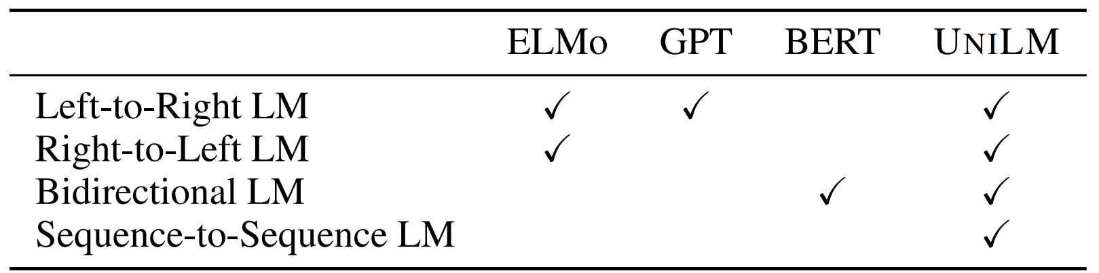
Unified pre-trained Language Model (UniLM)
Introduced in 2019 by Microsoft
Unified Language Model Pre-training for Natural Language Understanding and Generation (2019)
Multi objective Language Model
Used for both NLU and NLG tasks

Slide 5
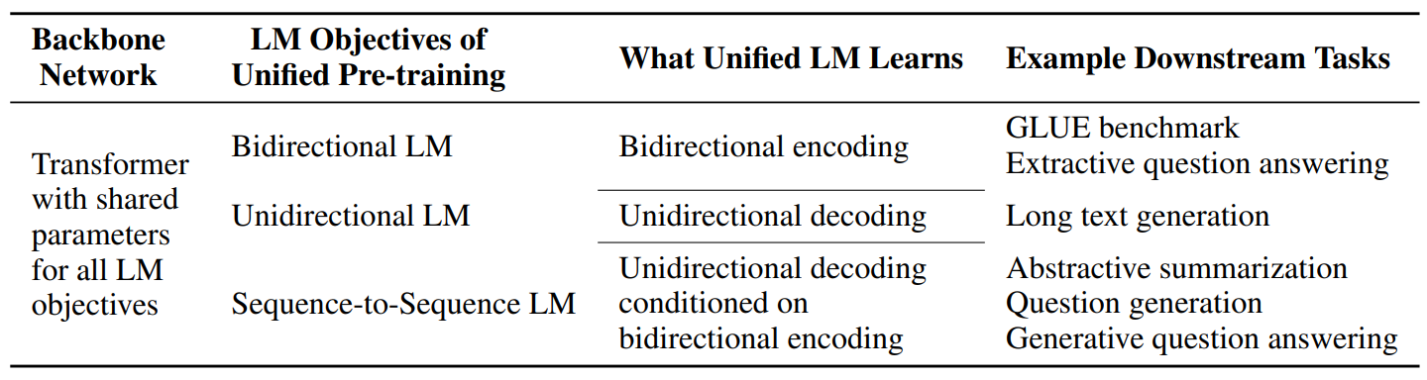
UniLM cont.
Unified pre-training leads to a single Transformer LM
Parameter sharing makes the learned representations more general
SOTA results on NLU and NLG tasks
Notes:
First, the unified pre-training procedure leads to a single Transformer LM that uses the shared parameters and architecture for different types of LMs, alleviating the need of separately training and hosting multiple LMs. Second, the parameter sharing makes the learned text representations more general because they are jointly optimized for different language modeling objectives where context is utilized in different ways, mitigating overfitting to any single LM task. Third, in addition to its application to NLU tasks, the use of UNILM as a sequence-to-sequence LM (Section 2.3), makes it a natural choice for NLG, such as abstractive summarization and question generation

Slide 6
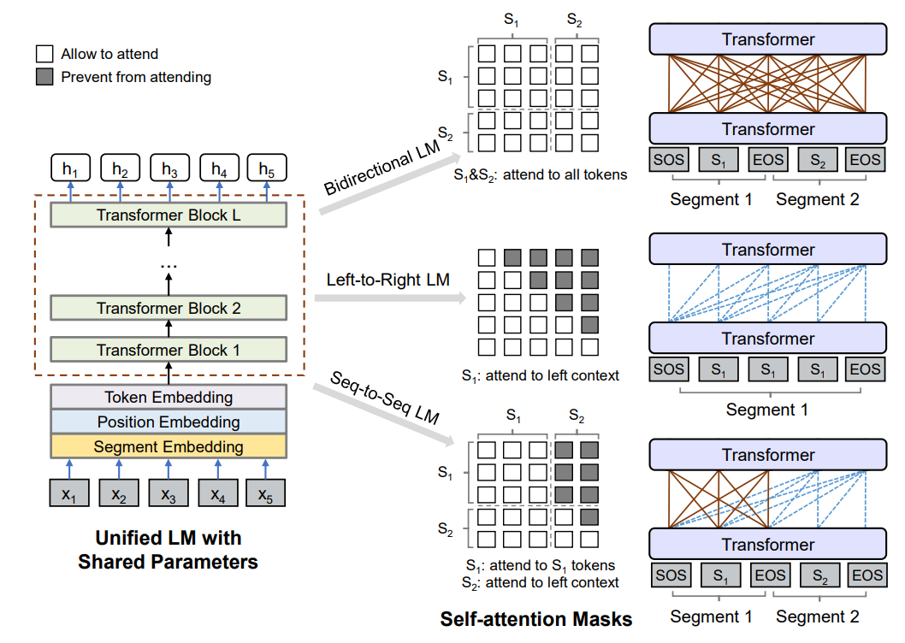
UniLM cont.
Notes:
Given the input [sos] s1 [eos] s2 [eos]
[eos] is used as sep and end of generation in nlg tasks
Multi layer transformer
4 different language models
Explain attention masks

Slide 7
UniLM cont.
Unidirectional LM
Left-to-right and right-to-left LMs are used
When predicting [M] in “x y [M] z” only x, y, [M] are available (LTR case)
Bidirectional LM
Similar to BERT
allows all tokens to attend to each other in prediction
Sequence-to-Sequence LM
The tokens in the “source”, attend to each other in both directions
But the tokens in the “target” only attend to leftward context
“[SOS] t1 t2 [EOS] t3 t4 t5 [EOS]”
Notes:
T4 example

Slide 8
Pretraining
Within one training batch
1/3 use the bidirectional LM
1/3 use the seq2seq LM
1/6 use both unidirectional LM
Architecture is similar to BERT_{Large}
Gelu Activation is used similar to GPT
384 million parameters
Trained in ~20 days with 7 Tesla v100 32GB GPUs
Notes:
The gelu activation [18] is used as GPT [31]. Specifically, we use a 24-layer Transformer with 1, 024 hidden size, and 16 attention heads, which contains about 340M parameters. The weight matrix of the softmax classifier is tied with token embeddings. UNILM is initialized by BERTLARGE, and then pre-trained using English Wikipedia2 and BookCorpus [53], which have been processed in the same way as [9]. The vocabulary size is 28, 996. The maximum length of input sequence is 512. The token masking probability is 15%. Among masked positions, 80% of the time we replace the token with [MASK], 10% of the time with a random token, and keeping the original token for the rest. In addition, 80% of the time we randomly mask one token each time, and 20% of the time we mask a bigram or a trigram. Adam [22] with β1 = 0.9, β2 = 0.999 is used for optimization. The learning rate is 3e-5, with linear warmup over the first 40, 000 steps and linear decay. The dropout rate is 0.1. The weight decay is 0.01. The batch size is 330. The pre-training procedure runs for about 770, 000 steps. It takes about 7 hours for 10, 000 steps using 8 Nvidia Telsa V100 32GB GPU cards with mixed precision training.

Slide 9
Finetuning on NLU and NLG Tasks
For NLU tasks, UniLM is finetuned as a bidirectional LM
[sos] instead of [cls] in BERT
For NLG tasks, UniLM is finetuned as a seq2seq LM
fine-tuned by masking some percentage of tokens in the target sequence at random, and learning to recover the masked words
Notes:
We use the encoding vector of [SOS] as the representation of input, denoted as h L 1 , and feed it to a randomly initialized softmax classifier

Slide 10
Results
NLU tasks
GLUE
Extractive Question Answering
NLG tasks
abstractive summarization
question generation
generative question answering
dialog response generation
Notes:
GLUE: General Language Understanding Evaluation (

Slide 11
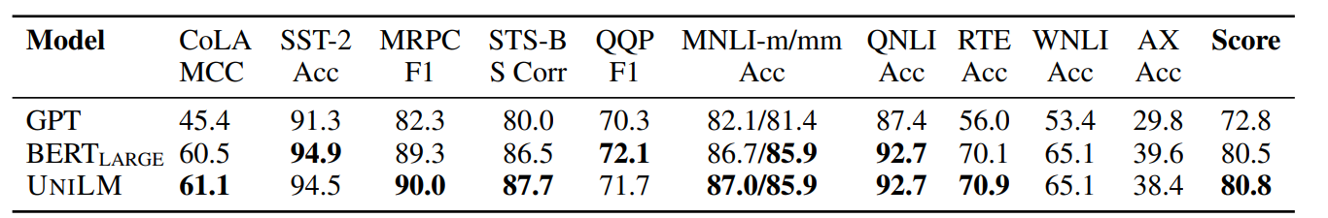
GLUE

Slide 12
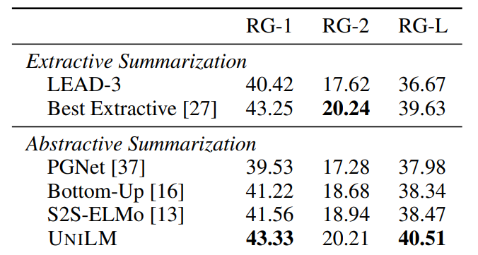
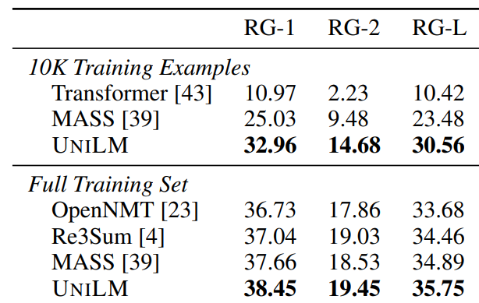
Summarization
CNN/DailyMail Summarization
Gigaword abstractive summarization
Notes:
Table 3: Evaluation results on CNN/DailyMail summarization. Models in the first block are extractive systems listed here for reference, while the others are abstractive models. The results of the best reported extractive model are taken from [27]. RG is short for ROUGE.
Table 4: Results on Gigaword abstractive summarization. Models in the first block only use 10K examples for training, while the others use 3.8M examples. Results of OpenNMT and Transformer are taken from [4, 39]. RG is short for ROUGE.

Slide 13
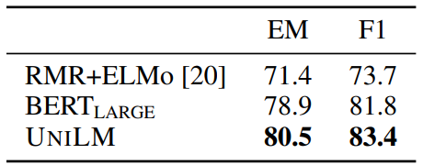
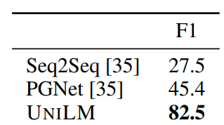
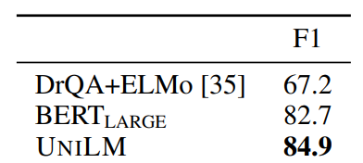
Question Answering
Extractive QA SQuAD
Extractive QA CoQA
Abstractive QA CoQA
Notes:
Table 5: Extractive QA results on the SQuAD development set.
Table 6: Extractive QA results on the CoQA development set.
Table 7: Generative QA results on the CoQA development set
in addition to the asked question, we concatenate the question-answer histories to the first segment, so that the model can capture conversational information. Secondly, for yes/no questions, we use the final hidden vector of the [SOS] token to predict whether the input is a yes/no question, and whether the answer is yes or no.

Slide 14
UniLM v2
Introduced in 2020 by Microsoft
UNILMv2: Pseudo-Masked Language Models for Unified Language
Introduces the concept of Pseudo-Masks
Partial Autoregressive objective
conventional masks to learn inter-relations between corrupted tokens and context
pseudo masks to learn intra-relations between masked spans
110M parameters vs 340M parameters

Slide 15
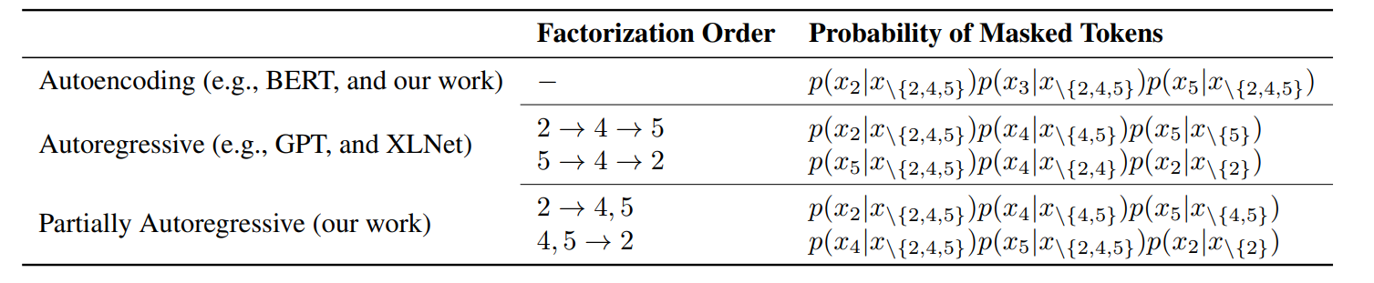
Partially Autoregressive Modeling
p(x2, x4, x5|x\{2,4,5}) = ?
Notes:
Table 1. Given input x = x1 · · · x6, the tokens x2, x4, x5 are masked. We compare how to compute p(x2, x4, x5|x\{2,4,5}) with different factorization orders for autoencoding, autoregressive, and partially autoregressive masked language models.

Slide 16
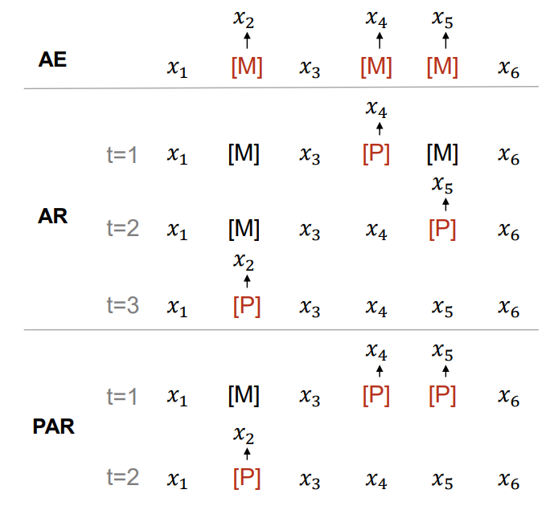
Partially Autoregressive Modeling
Notes:
Figure 3. Comparisons between autoencoding (AE), autoregressive (AR), and partially autoregressive (PAR) masked language models. In the example x = x1 · · · x6, the tokens x2, x4, x5 are masked by the special tokens [M] and [P].

Slide 17
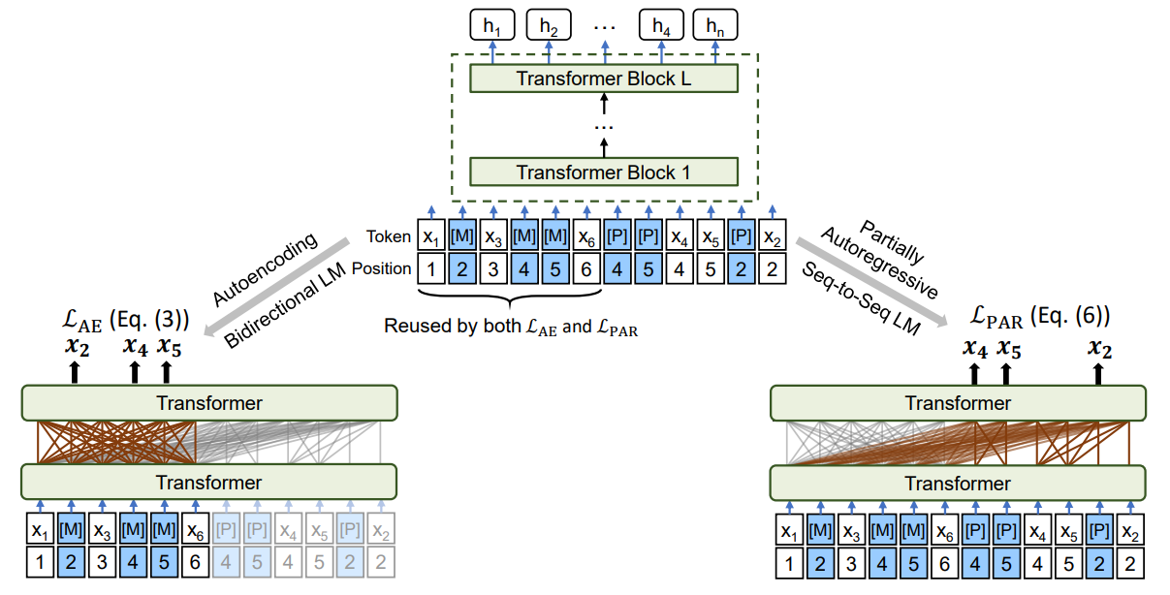
UniLM v2 Architecture
Notes:
Figure 2. Overview of PMLM pre-training. The model parameters are shared across the LM objectives. The bidirectional LM is trained by autoencoding MLM, and the sequence-to-sequence (Seq-to-Seq) LM is trained by partially autoregressive MLM. We use different self-attention masks to control the access to context for each word token

Slide 18
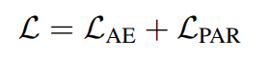
Pre-training and finetuning
Finetuning for NLU tasks is done similar to UniLM v1
Finetuning for NLG tasks
all the source tokens can attend to each other.
Target sequence is produced in an autoregressive manner
Append a pseudo mask [P] for each target token, and use self-attention masks to perform autoregressive generation
took about 20 days using 64 Nvidia V100-32GB GPU cards

Slide 19
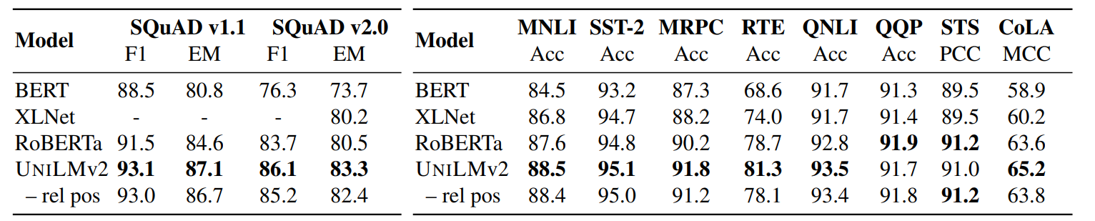
Results
SQuAD
GLUE
Notes:
Table 2. Results of BASE-size pre-trained models on the SQuAD v1.1/v2.0 development sets. We report F1 and exact match (EM) scores. Results of UNILMv2 are averaged over five runs. “– rel pos” is the model without relative position bias.
Table 3. Results of BASE-size models on the development set of the GLUE benchmark. We report Matthews correlation coefficient (MCC) for CoLA, Pearson correlation coefficient (PCC) for STS, and accuracy (Acc) for the rest. Metrics of UNILMv2 are averaged over five runs for the tasks. “– rel pos” is the ablation model without relative position bias.

Slide 20
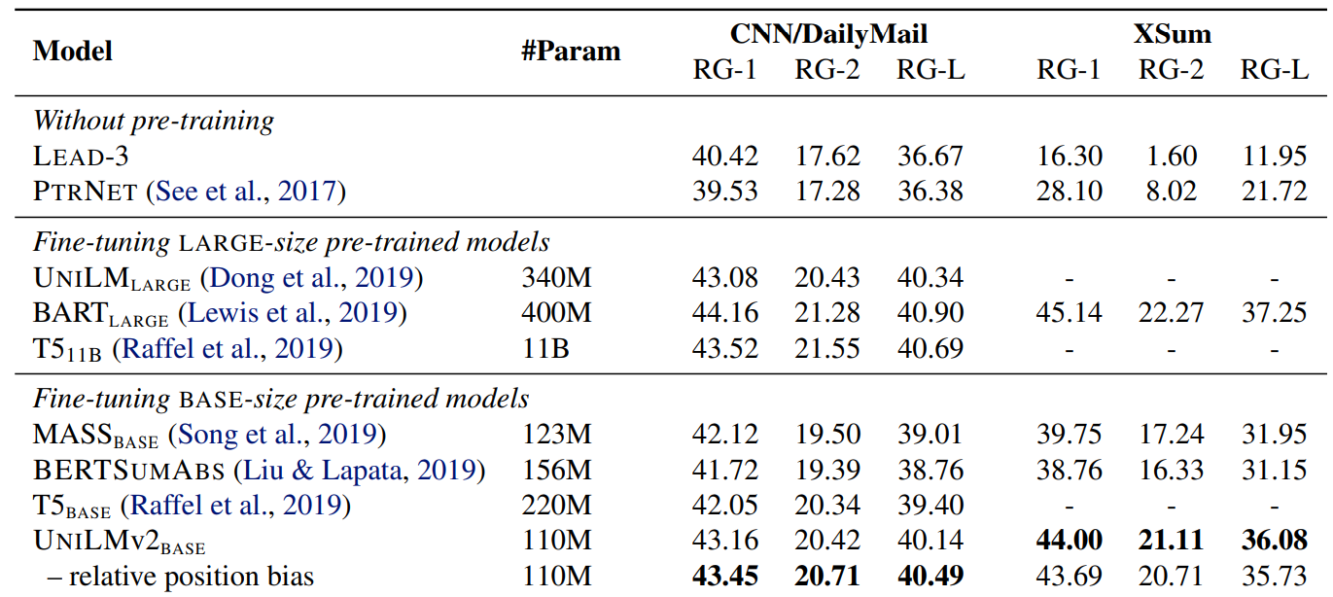
Results
Abstractive summarization results on CNN/DailyMail and XSum
Notes:
Table 4. Abstractive summarization results on CNN/DailyMail and XSum. The evaluation metric is the F1 version of ROUGE (RG) scores. We also present the number of parameters (#Param) for the methods using pre-trained models

Slide 21
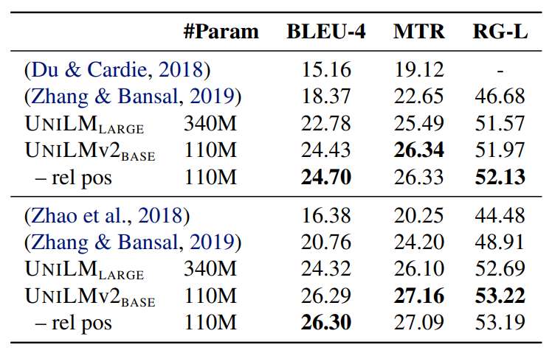
Results
Question generation
Notes:
Table 5. Results on question generation. The first block follows the data split in (Du & Cardie, 2018), while the second block is the same as in (Zhao et al., 2018). MTR is short for METEOR, and RG for ROUGE. “#Param” indicates the size of pre-trained models. “– rel pos” is the model without relative position bias

Slide 22
References
[1] Dong, Li, et al. "Unified language model pre-training for natural language understanding and generation." Advances in neural information processing systems 32 (2019).
[2] Bao, Hangbo, et al. "Unilmv2: Pseudo-masked language models for unified language model pre-training." International conference on machine learning. PMLR, (2020).

Slide 23
Conclusion
A new Unified pre-training Language Model
Jointly optimized for several LM objectives
SOTA results on both NLU and NLG tasks with a single model
UniLM v2 improves v1 by introducing partially autoregressive LM
Can be applied to multilingual scenario
Notes:
We propose a unified pre-training model, UNILM, which is jointly optimized for several LM objectives with shared parameters. The unification of bidirectional, unidirectional, and sequenceto-sequence LMs enables us to straightforwardly fine-tune the pre-trained UNILM for both NLU and NLG tasks. Experimental results demonstrate that our model compares favorably with BERT on the GLUE benchmark and two question answering datasets. In addition, UNILM outperforms previous state-of-the-art models on five NLG datasets: CNN/DailyMail and Gigaword abstractive summarization, SQuAD question generation, CoQA generative question answering, and DSTC7 dialog response generation. The work can be advanced from the following perspectives: • We will push the limit of the current method by training more epochs and larger models on webscale text corpora. At the same time, we will also conduct more experiments on end applications as well as ablation experiments to investigate the model capability and the benefits of pre-training multiple language modeling tasks with the same network. • We are focusing on monolingual NLP tasks in our current experiments. We are also interested in extending UNILM to support cross-lingual tasks [6]. • We will conduct multi-task fine-tuning on both NLU and NLG tasks, which is a natural extension of Multi-Task Deep Neural Network (MT-DNN) [26].

Slide 24
Thanks gholamrezadar@aut.ac.ir

